Slide 1


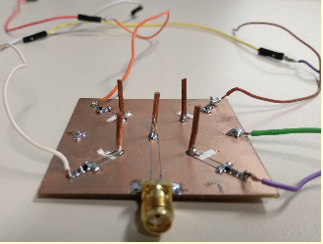
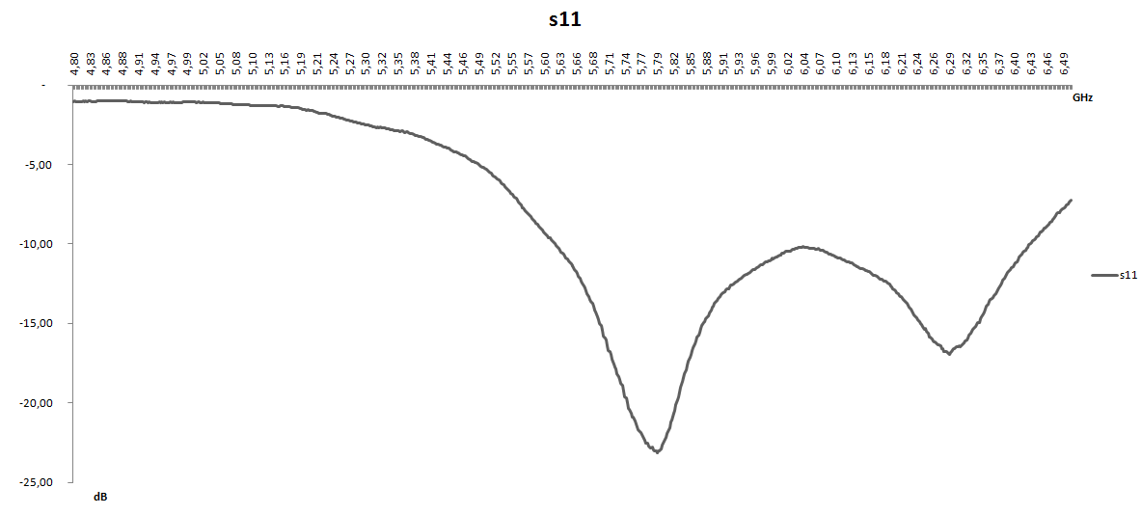
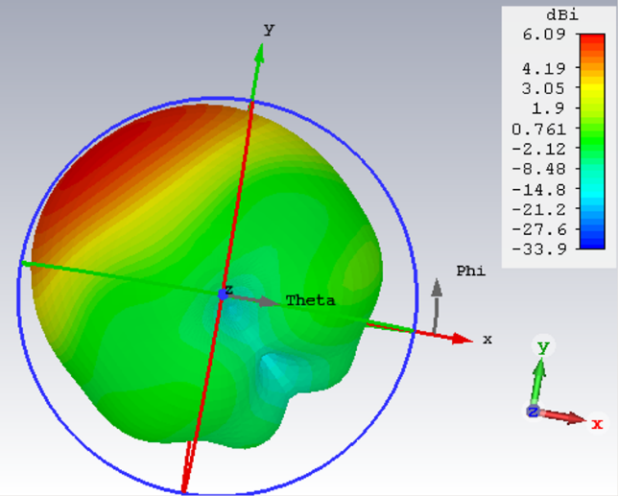
ANTENNA ARRAY
The incoming signal is received sequentially from four different directions in the azimuthal plane. With this purpose, we have used CST Microwave Studio to design a CPW (Coplanar Wave Guide)-Fed Monopole Antenna Array with Integrated PIN Diode Switches. This electrically steerable beam allows to reduce the power consumption and diminish multipath. The antenna is found to achieve a remarkable balance between complexity and performance.

Slide 2
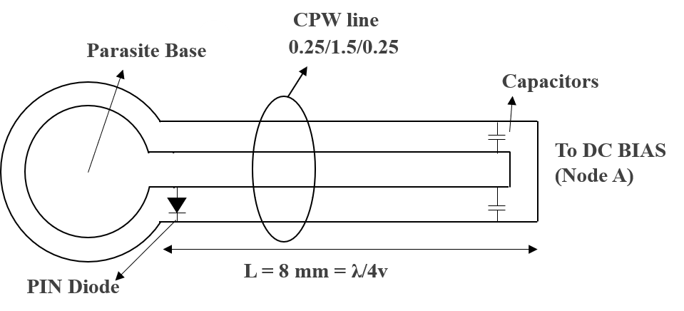
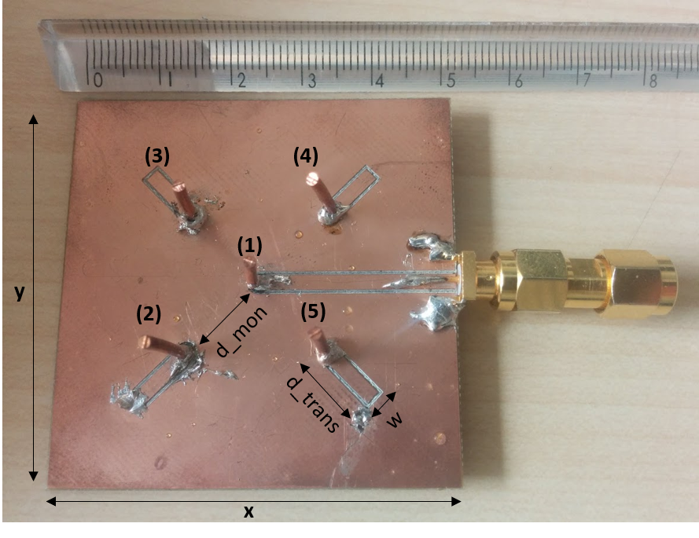
ANTENNA ARRAY
The driven element (1) is encircled by four parasite elements (2–5) of height 8mm (=4). The parasitic element configuration is controlled by a quarter wavelength CPW line.
Practically, capacitors and PIN diode switches are used to short- and open-circuit the CPW line to provide high and low impedance at the base of the parasite monopole. The PIN diode is placed about a quarter wavelength away from the capacitor, close to the parasite base (8mm). The configuration of the parasite element can be altered by providing enough current to the PIN diode switches (Fig.4). They act as a short circuit when supplied with 1V, and as an open circuit when they are not fed. The bias circuit for the diodes is composed by a 68nH inductor and a 115 resistor.

Slide 3
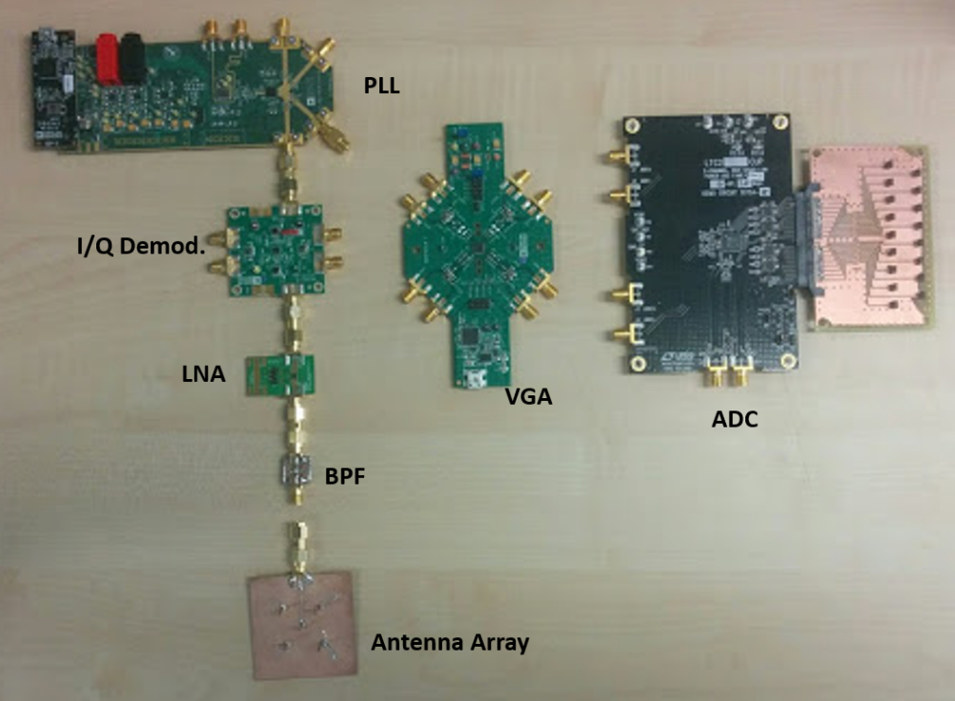
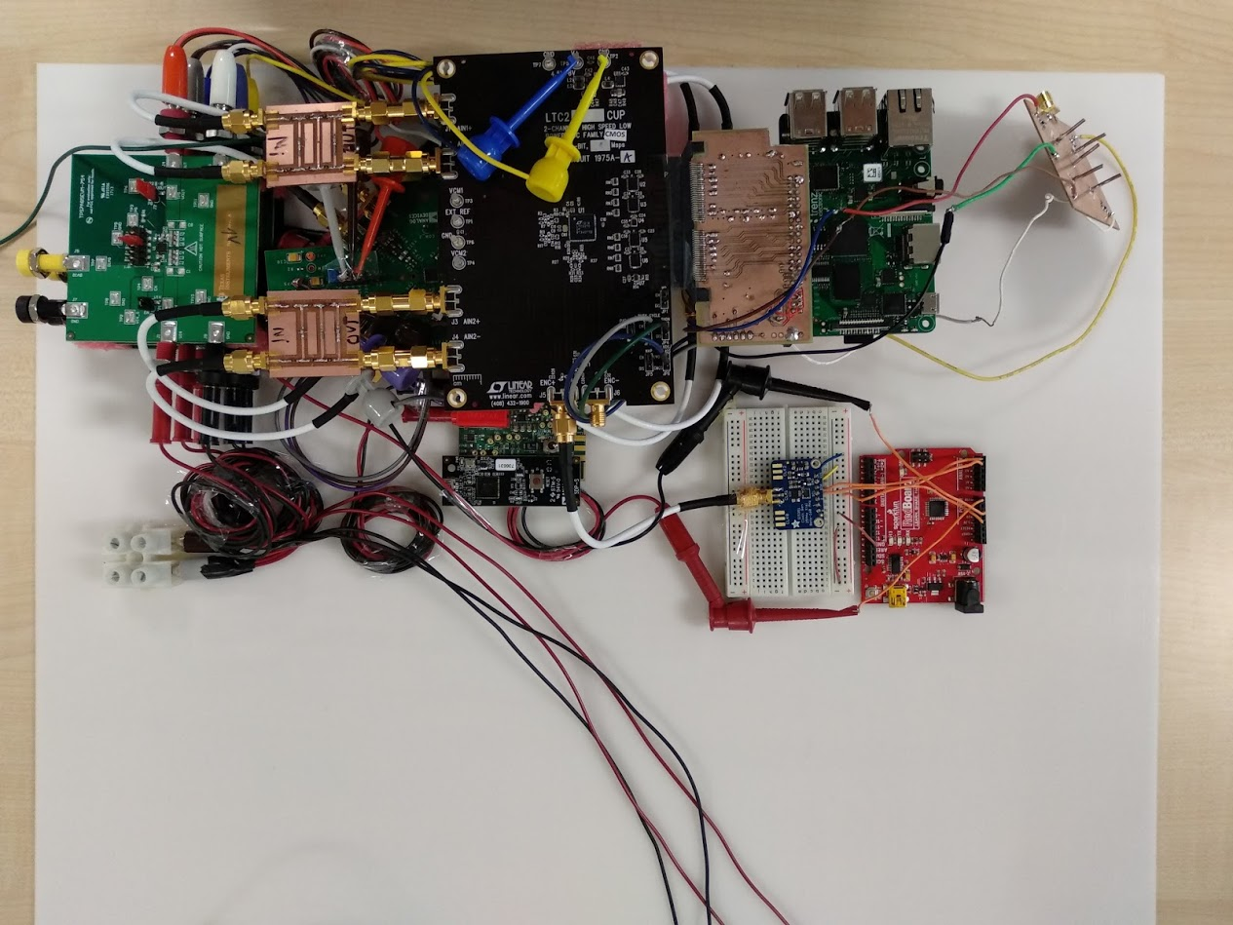
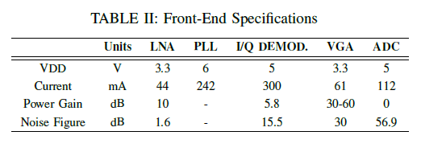
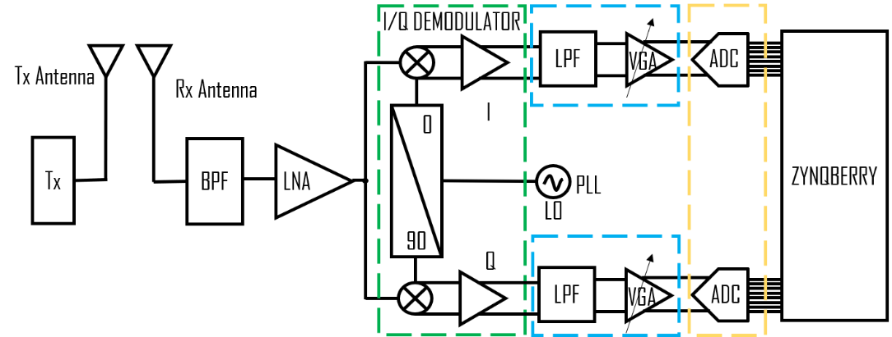
FRONT-END

Slide 4
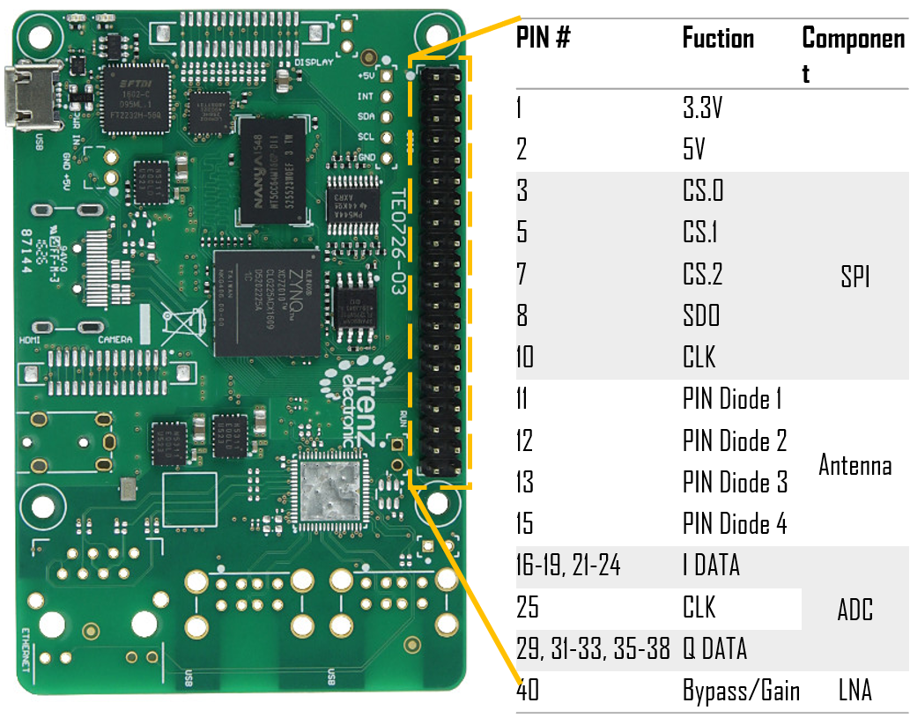
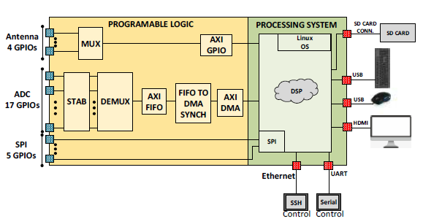
ADC-ZYNQBERRY

Slide 5


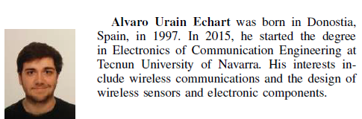
Iñigo Cortés:
icortesv@alumni.tecnun.es
Fátima Villa:
A903997@alumni.tecnun.es
Alvaro Urain:
A904590@alumni.tecnun.es

